Slide 1
Ggplot2 and interactive graphics with R
Christophe Ladroue
SECTION 05
VIDEO 05
Customizing legend titles and labels
www.PacktPub.com

Slide 2
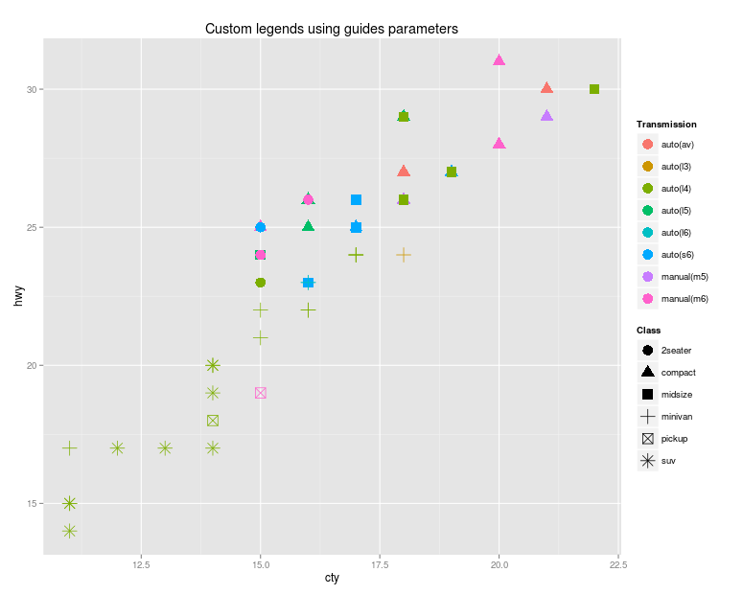
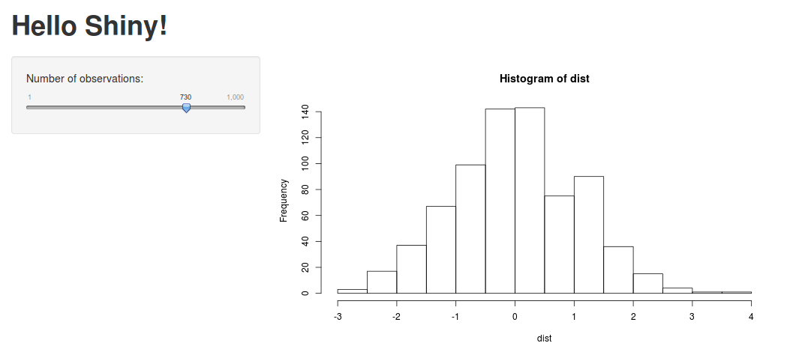
In this video we took a look at
customizing the labels for both axes.
customizing the legends using either the color palette or the more generic function ‘guides’
how to easily flip axes, without having to re-map the aesthetics.
Next: interactive webpages with Shiny

